Slide 1

FPT University
Android programMing
Lesson 15
Version 1.0

Slide 2
Agenda
Android 7 Multi-Window Support

Slide 3
Android 7 Multi-Window Support
Android 7 introduced a new feature in the form of multi-window support. Unlike previous versions of Android, multi-window support in Android 7 allows more than one activity to be displayed on the device screen at one time

Slide 4
Android 7 Multi-Window Support
Split-Screen, Freeform and Picture-in-Picture Modes
Split-screen mode
Freeform mode
Picture-in-picture mode

Slide 5
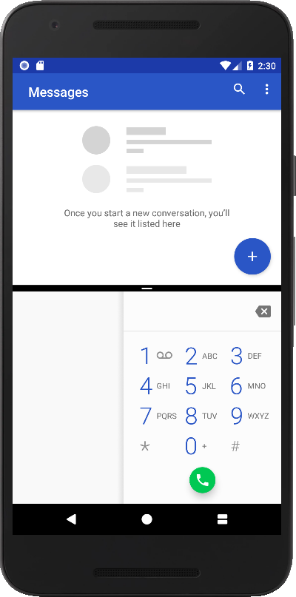
Android 7 Multi-Window Support
Split-screen mode
Available on most phone and tablet devices, provides a split screen environment where two activities appear either side by side or one above the other. A moveable divider is provided which, when dragged by the user, adjusts the percentage of the screen assigned to each of the adjacent activities

Slide 6
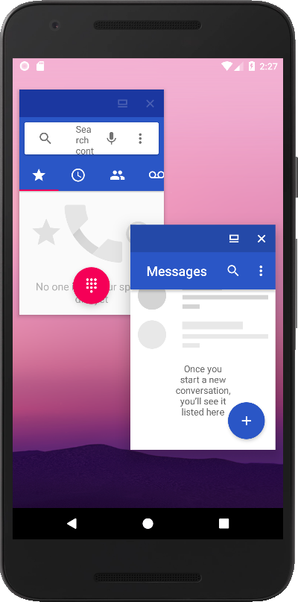
Android 7 Multi-Window Support
Freeform mode
provides a windowing environment on devices with larger screens and is currently enabled at the discretion of the device manufacturer. Freeform differs from split-screen mode in that it allows each activity to appear in a separate, resizable window and is not limited to two activities being displayed concurrently

Slide 7
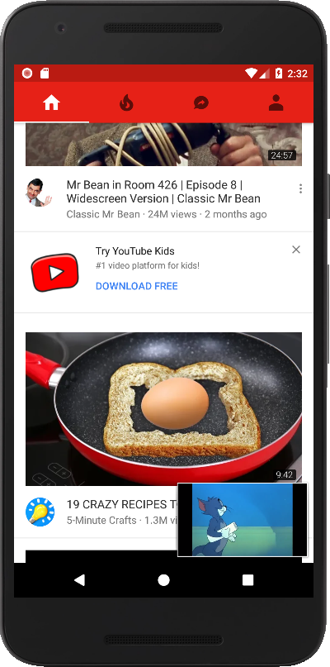
Android 7 Multi-Window Support
Picture-in-picture support
As the name suggests, allows video playback to continue in a smaller window while the user performs other tasks

Slide 8

Android 7 Multi-Window Support
Entering Multi-Window Mode - Split-screen mode can be entered by pressing and holding the square Overview button on the navigation bar until the display switches mode

Slide 9
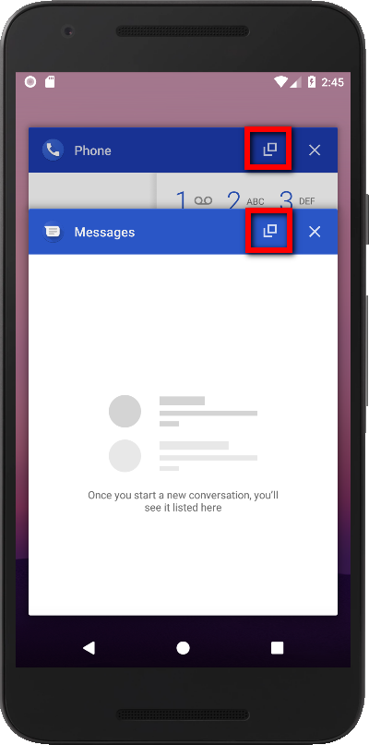
Android 7 Multi-Window Support
Entering Multi-Window Mode - In the case of freeform mode, an additional button appears within the title bar of the apps when listed in the Overview screen

Slide 10
Android 7 Multi-Window Support
Entering Multi-Window Mode - In the case of freeform mode, an additional button appears within the title bar of the apps when listed in the Overview screen

Slide 11
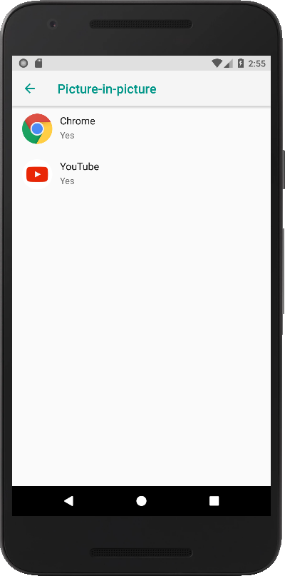
Android 7 Multi-Window Support
Entering Multi-Window Mode - Some application allowed to run in Picture-in-picture mode. To entering picture-in-picture mode, let’s the video play and go to the home screen.

Slide 12
Android 7 Multi-Window Support
Google is leaving the choice of whether to enable freeform multiwindow mode to the individual Android device manufacturers. Since it only makes sense to use freeform on larger devices, there is no guarantee that freeform will be available on every device on which an app is likely to run. Fortunately all of the freeform specific methods and attributes are ignored by the system if freeform mode is not available on a device, so using these will not cause the app to crash on a non-freeform device.

Slide 13
Android 7 Multi-Window Support
Enable FreeForm mode
- Locate to the Android\sdk\platform-tools folder and run command shell.
Connect phone to the PC
Run the following commands:
adb devices adb shell settings put global enable_freeform_support 1

Slide 14
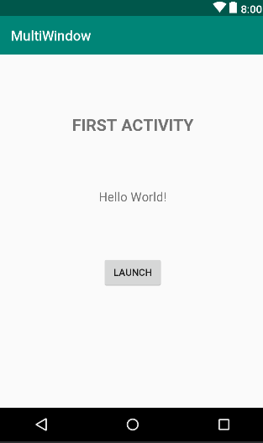
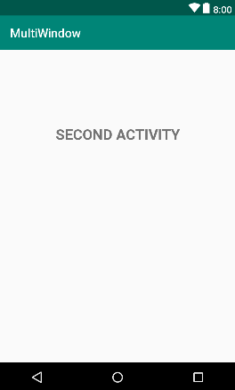
Android 7 Multi-Window Support
Designing the FirstActivity User Interface

Slide 15
Android 7 Multi-Window Support
Launching the Second Activity in a Different Window
public void launchIntent(View view) { Intent i = new Intent(this, SecondActivity.class); i.addFlags(Intent.FLAG_ACTIVITY_LAUNCH_ADJACENT| Intent.FLAG_ACTIVITY_MULTIPLE_TASK| Intent.FLAG_ACTIVITY_NEW_TASK); startActivity(i); }

Slide 16
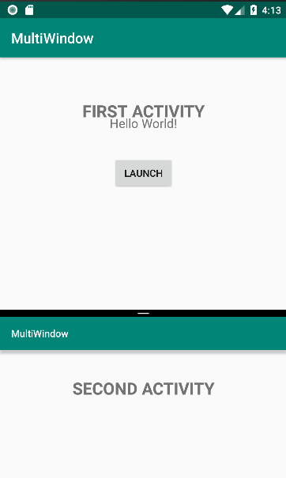
Android 7 Multi-Window Support
Testing application on Split-screen mode

Slide 17
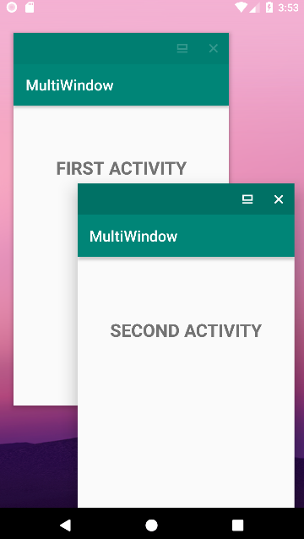
Android 7 Multi-Window Support
Testing application on free form mode

Slide 18
Android 7 Multi-Window Support
Changing the Freeform Window Position and Size
public void launchIntent(View view) { Intent i = new Intent(this, SecondActivity.class); i.addFlags(Intent.FLAG_ACTIVITY_LAUNCH_ADJACENT| Intent.FLAG_ACTIVITY_MULTIPLE_TASK| Intent.FLAG_ACTIVITY_NEW_TASK); Rect rect = new Rect(0, 0, 100, 100); ActivityOptions options = ActivityOptions.makeBasic(); ActivityOptions bounds = options.setLaunchBounds(rect); startActivity(i, bounds.toBundle()); }

Slide 19

End of Lesson 15

Slide 20
Thank you!

